Slide 1
Vehicle Speed Detection
Shubhankar Joshi Roll no -18
Guide: Prof. Jitendra Gaikwad

Slide 2

Contents
Introduction
Objective
Literature Review
Programming Language
Methodology

Slide 3
Problem statement
To develop machine learning model which will help to detect the speed of a vehicle using video footage.

Slide 4
Introduction
Over speeding is one the major reasons of accidents.
With help of this model speed of vehicles can be calculated using CCTV footage

Slide 5

Objectives
To develop a program which will track and detect the vehicle from CCTV footage
To create a model which will track and detect the speed of vehicle

Slide 6
Literature Review
Vehicle speed detection in video image sequences using CVS methodArash Gholami Rad Abbas Dehghami International Journal of the Physical Sciences V
Speed Detection Software Himanshu Dwivedi Arunim Garg International Journal of Engineering Research & Technology (IJERT) ISSN: 2278-0181
Vehicle Speed Detection using Camera and Image Processing software, Hakan Koyuncu Computer Engineering Department, Istanbul Gelisim University, Baki Koyuncu, Electrical and Electronics Engineering Dept.

Slide 7
Programming Language
Python, Opencv,Dlib,
Jupyter notebook.

Slide 8
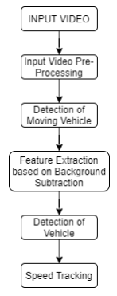
Flowchart

Slide 9
Methodology
Learning Object Tracking and Computer Vision
Detect and track vehicles using Haarcascade classifier
Select the area where the vehicle is starting
Estimate the time for speed detection
Calculate average kilometer per hour

Slide 10
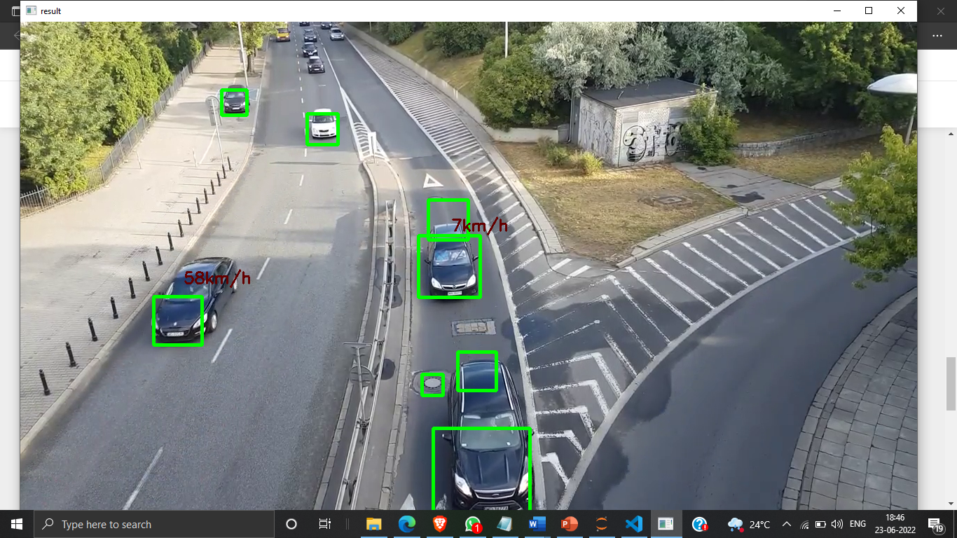
Results

Slide 11
THANK YOU!

